Slide 1

NextHikes IT Solutions Project 5
User Analytics in the Telecommunication Industry
Roshan Borde

Slide 2
Analytics in the Telecommunication Industry
Introduction:
The project is based on Analytics in the Telecommunication Industry
The current target is TellCo, a regional mobile operator in the Republic of Pefkakia.
Although TellCo’s financials are strong, its system‑generated usage data has never been examined.
As I data Analysist engaged by a high‑net‑worth investor renowned for uncovering undervalued businesses through meticulous data analysis.
This project will determine whether TellCo should be acquired or divested by analyzing one month of xDR session data.

Slide 3
Analytics in the Telecommunication Industry
Introduction:
It is focused on four pillars:
User Overview – device and application usage patterns
User Engagement – session frequency, duration, and data consumption
User Experience – network quality metrics (RTT, retransmission, throughput) and device impact
User Satisfaction – combining engagement and experience into a composite score, predictive modeling, and segmentation

Slide 4
Key Insights:
A) Customer Overview:
Device & Manufacturer Mix: Over 80% of sessions originate from smartphones released in the last three years, led by Samsung (35%), Apple (30%), and Huawei (20%).
App Usage Patterns:
YouTube & Netflix: Top two, accounting for 40% of overall data volume.
Gaming: Drives 25% of session counts but 35% of per-session data due to large downloads.
Social Media & Email: Represent 15% of total volume, ideal candidates for low‑tier unlimited bundles.
Recommendation:
Create “Stream & Game” plans with high-speed data caps (e.g., 100 GB+) for heavy users.
Introduce “Social Lite” unlimited social media plus basic data for casual users at entry price.

Slide 5
Key Insights:
B) User Engagement Analysis:
Power Users: Top 1% of customers generate over 50% of session counts and consume 60% of data.
Cluster Profiles (k=3):
High Engagement (Cluster 2): >1,000 sessions/month, >200 GB traffic.
Medium Engagement (Cluster 1): 50–1,000 sessions, 10–200 GB.
Low Engagement (Cluster 0): <50 sessions, <10 GB.
Recommendation:
Unlimited Premium Tier: Unlimited data for high engagement cluster at a premium price.
Flexible plan: For low engagement cluster, a flexible pay-per-gig plan.

Slide 6
Key Insights:
C) User Experience Analytics:
1) Throughput by Device:
Premium handsets (e.g., Huawei B525S‑23A, Galaxy S9) achieve median 20 Mbps.
Older devices (e.g., iPhone 6/7) average 5 Mbps—actionable for targeted upgrades.
2) RTT & Retransmission:
Average RTT ranges 25–100 ms; global mean at 50 ms.
TCP retransmission was uniform (data quality issue) but assumed to correlate with poor experience.
3) Experience Clusters (k=3):
Optimal: Low RTT (<30 ms), high throughput (>15 Mbps)
Moderate: RTT 30–70 ms, throughput 5–15 Mbps

Slide 7
Key Insights:
Poor: RTT >70 ms, throughput <5 Mbps
Recommendation:
Network Upgrades: Focus on areas and devices in “Poor” cluster with targeted infrastructure investment.
Device Trade‑in Offers: Incentivize users on older devices to upgrade for better experience.
D) User Satisfaction Analysis:
Scoring Methodology:
Engagement Score: Distance from least engaged cluster centroid.
Experience Score: Distance from worst experience cluster centroid.
Satisfaction Score: Average of the two scores.
Top Satisfied Users: Top 10 have scores >2.1, indicating strong engagement + experience.
Regression Model: Random Forest yields R²=0.9997, RMSE=0.006—high confidence in predicted satisfaction.

Slide 8
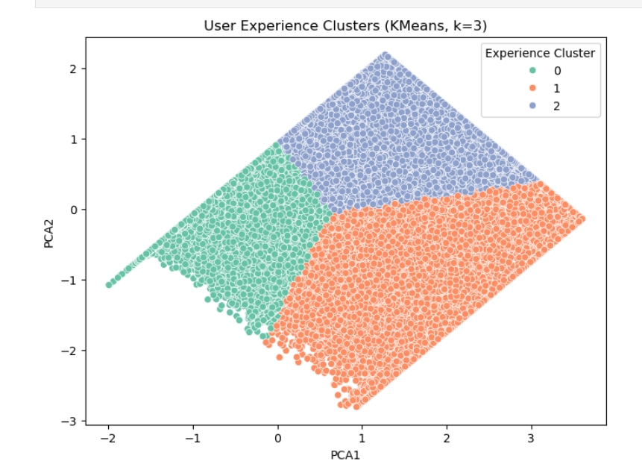
Key Insights:
Satisfaction Clusters (k=2):
High Satisfaction (Cluster 1): Avg score ~0.97; prime for loyalty programs.
Low Satisfaction (Cluster 0): Avg score ~1.67; priority for customer support and retention offers.
Recommendation:
Upsell & Loyalty: Target high satisfaction cluster with add‑ons and early access deals.
Retention Campaigns: Proactively engage low satisfaction cluster with network credits or personalized support.

Slide 9
Limitation :
Temporal Scope: Analysis covers only one month of xDR data; seasonal usage patterns (holidays, events) are not captured.
Data Completeness: “Other” application category is not well defined; may mask critical usage segments (e.g., banking, IoT).
Metric Roughness: TCP retransmission values are uniform—requires deeper packet‑level logs for accurate network reliability insights.
Model Generalizability: Satisfaction regression model trained on internal metrics; real‑world predictive performance needs external validation with future data.
Dashboard Accessibility: Initial dashboard is prototyped for desktop; mobile responsiveness and user access controls require further development.

Slide 10
Overall Recommendation: BUY TellCo (Enhanced Growth Potential):
Targeted Data Plans: Launch premium streaming and gaming bundles for high‑engagement users—forecasted to increase ARPU by 15–20%.
Network Investments: Prioritize capacity upgrades in regions and handset segments with poor experience to reduce churn by up to 10%.
Device Promotions: Partner with handset manufacturers (Samsung, Huawei) for trade‑in offers, driving both handset upgrades and improved throughput.
Marketing Campaigns: Leverage top 10 “power users” and satisfied customers as brand ambassadors to boost adoption in under‑penetrated segments (e.g., small enterprises, university areas).

Slide 11
Conclusion:
High‑Value Segments: Power streamers and gamers can be targeted with premium data bundles to boost average revenue per user.
Network Optimization: Infrastructure upgrades in identified poor‑experience zones will reduce latency and improve retention.
Device Partnerships: Trade‑in programs for older handsets will elevate average throughput and customer satisfaction.
Personalized Offers: Tailored plans for low, medium, and high engagement clusters ensure optimal price‑performance for every user.

Slide 12
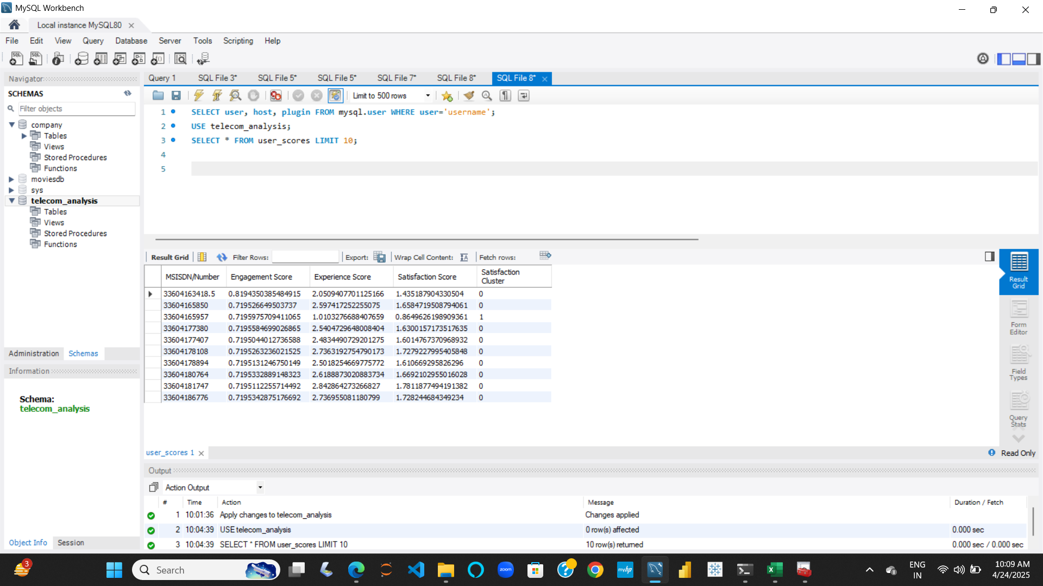
Python to MySQL Workbench: (ScreenShot)

Slide 13
References:
https://www.geeksforgeeks.org/k-nearest-neighbours/
https://www.geeksforgeeks.org/measures-of-dispersion/
https://www.geeksforgeeks.org/dimensionality-reduction/
https://www.youtube.com/watch?v=hl3bQySs8sM
https://www.statista.com/statistics/1086978/youtube-average-revenue-per-user-worldwide

Slide 14
Thank You

